Slide 1
Python Programming for Data Science

Slide 2

Learning Objectives
At the end of this lecture, you should understand:
Essential concepts and techniques of computer programming using Python:
Overview of Python and Its Syntax.
Variables, Operators and Arithmetic Expressions.
Basic Input and Output.
Conditional Control Flow.
Iterative Control Flow.
Basic Data Structures.
How to solve simple computational problems using Python.

Slide 3

Overview of Python
Python is a general purpose programming language:
Can be used with Django to create web applications.
Many specialised libraries are widely available that allows Python to be used in domain-specific scientific computing.
Especially suitable for data analytics, i.e., SciPy libraries.
Characteristics of Python:
Python is an interpreted language.
Python interpreter is supported on various operating systems and environments.
Python is a high-level programming language:
Uses symbolic instructions.
Uses symbolic names to reference memory locations.

Slide 4

Overview of Python (cont.)
Interpreted language:
Instructions written in high-level language is directly interpreted by a special software known as interpreter.
The interpreter then executes a corresponding machine language instruction to complete the task.
Process:
Python code
Interpretation
Execution

Slide 5
Overview of Python (cont.)
Using Python as an imperative programming language:
Imperative programs define sequences of commands for the computer to perform.
These commands manifest as statements that change the state of a program.
The program state is the data or information that it is tasked to manipulate.
In practical sense, the program state exists in the computer’s main memory and is referenced by symbolic names, i.e., variables.
Python is intended to be a clean, simple and highly readable language that is easy for beginners to learn ☺

Slide 6
Identifiers
 We need to name variables (and functions) in Python.
 Official word for name is identifier – An identifier
uniquely identifies either a variable or a function.
 An identifier in Python must satisfy the following three conditions:
It must start with a letter (A-Z, a-z) or the underscore
character (_).
It must consist of only letters (A-Z, a-z), digits (0-9), and the underscore character (_).
It must not be a keyword or reserved word such as
while, which has a special meaning in Python.

Slide 7
Identifiers (cont.)
 All identifiers, indeed everything in Python, are case- sensitive:
 Num1 and num1 are thus two distinct identifiers representing two distinct variables (or functions).
 Variables are set with specific values via the assignment
operation.
 Good practice to use meaningful variable names.
 In Python convention, identifier uses lowercase letters and words are separated with “_”
 e.g. sum, total_sum, age

Slide 8
Assignment Operator
 The assignment operator = is used to assign a literal value or a value of another variable to a variable.
 Assignment statement: VARIABLE1 = VALUE VARIABLE2 = VARIABLE1

Slide 9
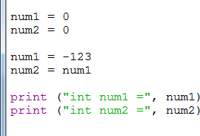
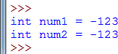
Integer Values (cont.)

Slide 10
Floating-Point Values
 Floating-point values represent numbers with fractional parts.
 Floating-point numbers can be expressed in two ways:
 Standard notation:
 m.nnnnnn, e.g., 33.900000
 Scientific notation:
 m.nnnnnne±xx, e.g., 3.141590e+03
 m.nnnnnnE±xx, e.g., 3.141590E+03
 Floating-Point Limits:
 Internal memory size used to store a float value is 16 bytes.
 Maximum positive value of float = 1.7976931348623157e+308
 Minimum positive value of float = 2.2250738585072014e-308

Slide 11
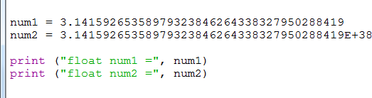
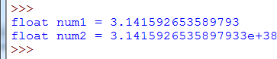
Floating-Point Values (cont.)

Slide 12
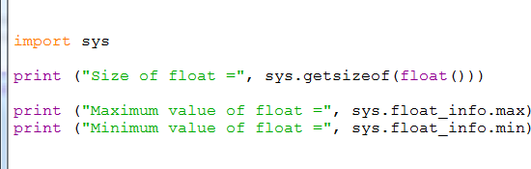
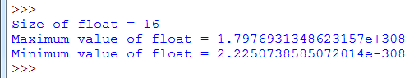
Floating-Point Values (cont.)

Slide 13
String Values
 A string value contains an ordered sequence of characters.
 E.g., 'Hello World'
 A string can be expressed using single or double quotation marks
 E.g., 'Hello World' is the same as "Hello World"
 len is used to obtain the length of the string.
 E.g., len('Hello World')

Slide 14
String Values (cont.)
 As string is a sequence type, indexing can be used to select a character within a string
 Example, to select the first character:
 word = 'Hello World'
 word[0]
 The first character is located at index zero
 The last character is indexed at the location that is one less than the length of the string
 Strings are immutable, i.e. cannot modify individual characters.

Slide 15
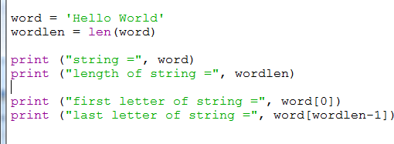
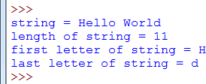
String Values (cont.)

Slide 16
String Slicing
 Substrings can be extracted from strings using slicing
 word = "Hello World"
 word[1:8]
 word[1:8:2]
 string[start:stop:step]
 Gets the character from start, to stop (exclusive) in
intervals of step
 Negative index counts from the back
 word[-1]
 word[-1:0:-1]

Slide 17
Boolean Values
 There are only two Boolean values:
 Usually denoted as true and false.
 Represent the truth values of logic.
 Boolean values in Python:
 False for false
 True for true
 Just like integers, floating-point and string values, boolean values can be assigned to variables.
 In general, any value that does not evaluate to zero is considered true.

Slide 18
Type Conversion
 Performs explicit data type conversion with the following
 int converts to integer, e.g., int(9.87) evaluates to 9
 float converts to floating-point value , e.g., float(9)
evaluates to 9.0
 str converts to string, e.g., str(9.87) evaluates to '9.87'
 bool converts to boolean value, e.g., bool(9.87) evaluates
to True
 Exercise caution when using type conversion:
 Invalid conversion, e.g., int('a')
 Truncation of fractional value from float to int.
 Loss of precision.

Slide 19
Arithmetic Operators
 Python provides several binary arithmetic operators.
Operator | Description | Example
+ | Add | 8 + 2 = 10
- | Subtract | 8 - 2 = 6
* | Multiply | 8 * 2 = 16
/ | Floating-point divide | 8 / 2 = 4.0 9 / 2 = 4.5
// | Integer divide | 9 // 2 = 4
% | Modulus – Remainder when num1 is divided by num2 | 8 % 2 = 0 9 % 2 = 1
** | Exponentiation | 8 ** 2 = 64

Slide 20
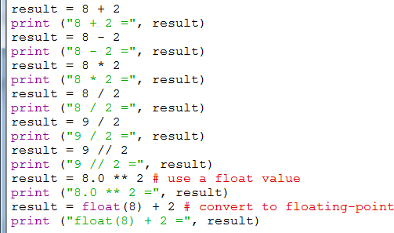
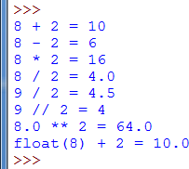
Arithmetic Operators (cont.)
 Operates on integer and floating-point number
 As long as one of the operands is a floating point, the result of operation always produces a floating point number.

Slide 21
Relational Operators
 Python provides six relational (comparison) operators that return either False or True.
 In the case of binary operations (e.g., x < y), the relational operator compares the operand on the left hand side with the operand on the right hand side.
 Comparisons can be also be chained arbitrarily.
E.g., x < y <= z is equivalent to x < y and y <= z
 Numbers (int and float) are compared numerically.
 Strings are compared lexicographically, i.e., dictionary order.

Slide 22
Relational Operators (cont.)
 In the following table, we compare integer numbers:
Operator | Description | Example
== | Equal | 8 == 8 returns True 8 == 9 returns False
!= | Not Equal | 8 != 8 returns False 8 != 9 returns True
> | Greater Than | > 8 returns False > 8 returns True
>= | Greater Than or Equal | >= 8 returns True >= 8 returns True
< | Less Than | 8 < 8 returns False 8 < 9 returns True
<= | Less Than or Equal | 8 <= 8 returns True 8 <= 9 returns True

Slide 23
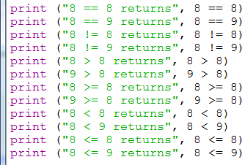
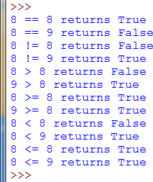
Relational Operators (cont.)

Slide 24
Logical Operators
 Python provides two binary logical operators and one unary logical operator.
Operator | Description
and | Logical And
or | Logical Or
not | Logical Not
 These logical operators return the corresponding Boolean truth values shown in the table below.
x | y | x and y | x or y | not x
True | True | True | True | False
True | False | False | True | False
False | True | False | True | True
False | False | False | False | True

Slide 25
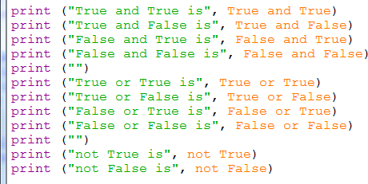
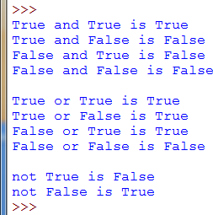
Logical Operators (cont.)

Slide 26
Assignment with Arithmetic Operators
 Python provides a shorthand notation to use arithmetic operators concurrently as assignment operators:
Operator | Example | Equivalent
+= | num += 8 | num = num + 8
-= | num -= 8 | num = num - 8
*= | num *= 8 | num = num * 8
/= | num /= 8 | num = num / 8
//= | num //= 8 | num = num // 8
%= | num %= 8 | num = num % 8
**= | num **= 8 | num = num ** 8

Slide 27
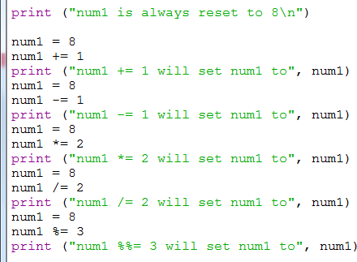
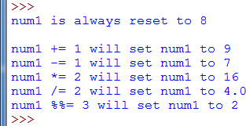
Assignment with Arithmetic Operators
(cont.)

Slide 28
Operator Precedence and Associativity
 Python operators have different levels of precedence:
 An operator with higher precedence is always evaluated first
before another operator of lower precedence.
 For instance, multiply has higher precedence than add and so multiply is evaluated before add.
 E.g., 8 + 9 * 2 is evaluated as 8 + (9 * 2) = 26
 A good practice is to use parentheses to explicitly indicate the desired evaluation precedence:
 Parentheses have the highest operator precedence.
 Parentheses are evaluated from inner to outer.
 E.g., (8 + 9) * 2 will always be evaluated as 17 * 2 = 34

Slide 29
Operator Precedence and Associativity
(cont.)
 Operators of the same level of precedence are evaluated in order of the associativity:
 Left associativity means the expression is evaluated from left-to-right.
 E.g., num1 / num2 / num3 is evaluated as (num1 / num2) / num3
 Right associativity means the expression is evaluated from right-to-left.
 E.g., num1 ** num2 ** num3 is evaluated as
num1 ** (num2 ** num3)
 Most arithmetic operators in Python are left associative except the exponentiation operator which is right associative.
 Operator precedence table for Python 3
 https://docs.python.org/3/reference/expressions.html#operator-precedence

Slide 30
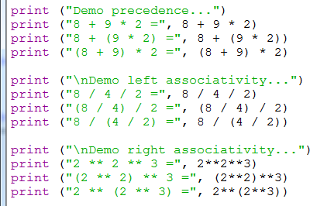
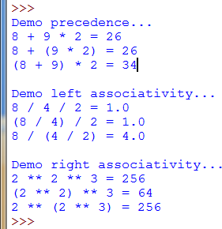
Operator Precedence and Associativity
(cont.)

Slide 31
Standard Output in Python
 Standard output in Python 3. x is performed with the
print function.
print(obj, …, sep=' ', end='\n',
file=sys.stdout, flush=False)
 Using print in its simplest form: print(val, …)
 Each object obj can be any valid value or variable.
 Multiple objects may be output.
 Each object is separated with a blank space (default separator)
 A newline terminates the output (default end character)
 Try the following:
 num = 3
 print("num", num)
 print("num", num, sep='=', end='.\n')

Slide 32
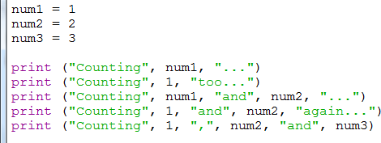
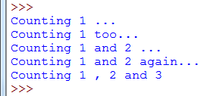
Standard Output in Python (cont.)
 print can take in a number of values or variables to be printed.

Slide 33
String Formatting
 Use the function .format:
 With string formatting, print allows values or variables to be printed out using placeholders.
 The placeholder curly bracket {} denotes what is to be substituted.
 Example:
 print("{} is the weight of {} apples".format('Hello Kitty', 3))
 Can put numbers in the brackets to denote position:
 print("First: {0}, Second:{1}, Third:{2}".format(1, 2, 3))

Slide 34
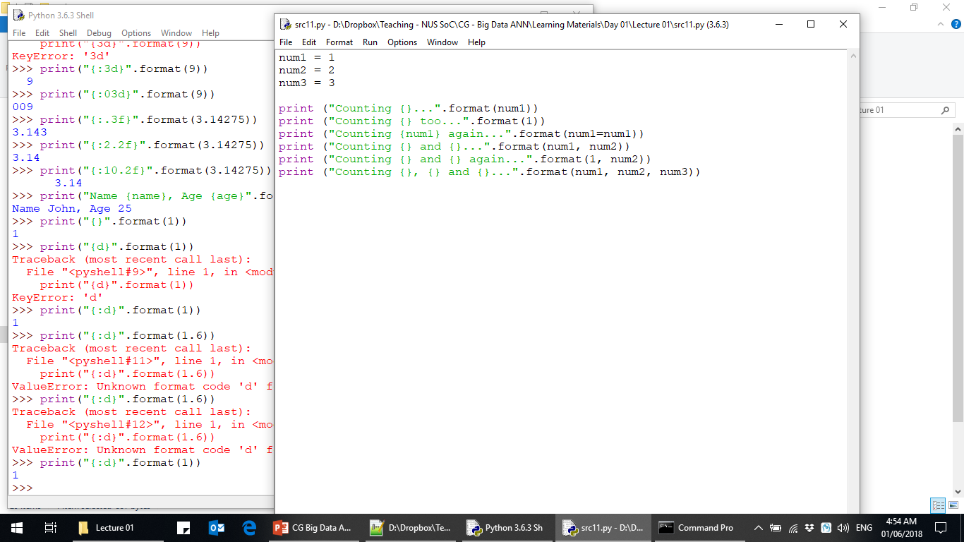
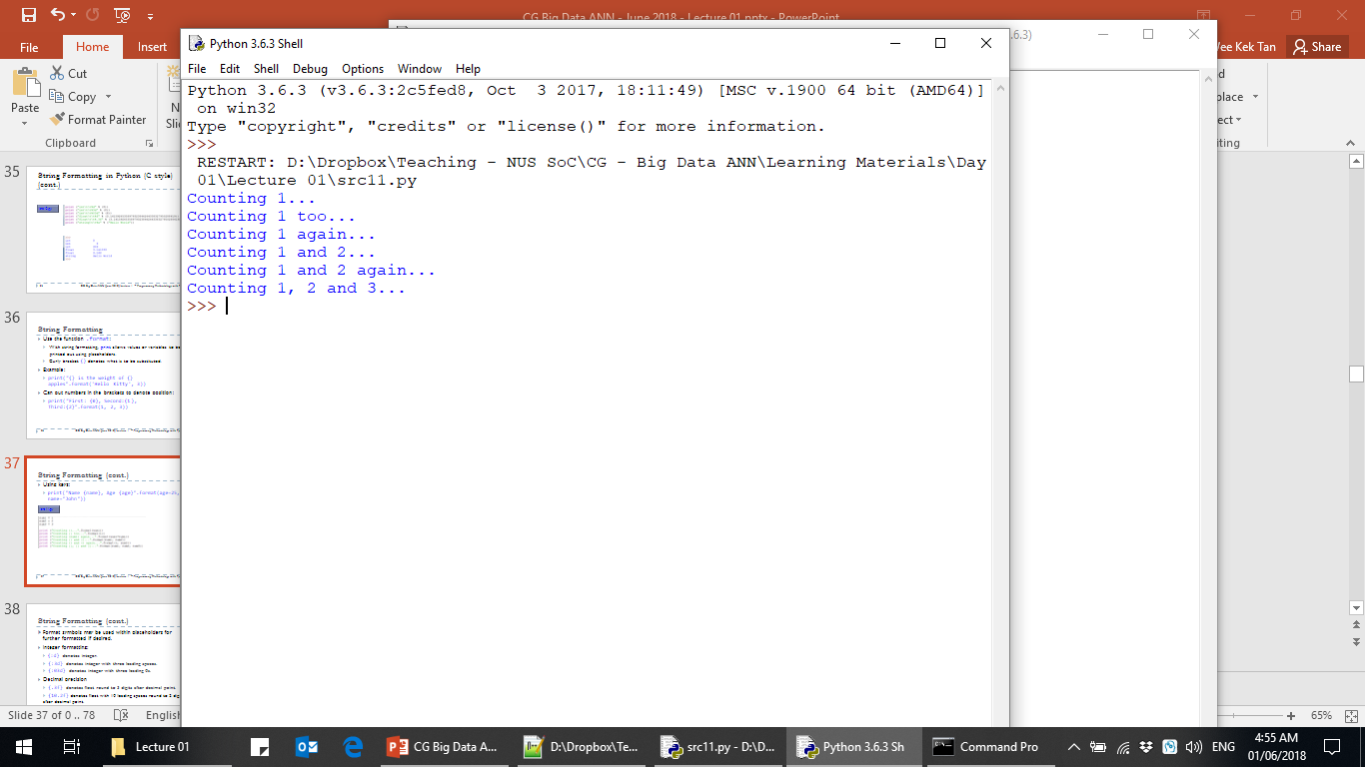
String Formatting (cont.)
 Using keys:
 print("Name {name}, Age {age}".format(age=25, name="John"))

Slide 35
String Formatting (cont.)
 Format symbols may be used within placeholders for further formatted if desired.
 Integer formatting:
 {:d} denotes integer.
 {:3d} denotes integer with three leading spaces.
 {:03d} denotes integer with three leading 0s.
 Decimal formatting and precision:
 {:.3f} denotes float round to 3 digits after decimal point.
 {:10.2f} denotes float with 10 leading spaces round to 2 digits after decimal point.
 String justification and spacing:
 "Name {:<20s}, Age {:>2d}".format("John", 9)

Slide 36
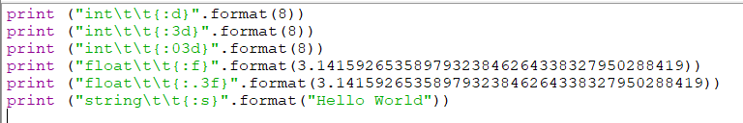
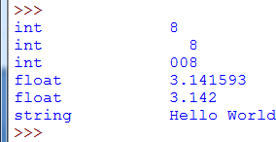
String Formatting (cont.)

Slide 37
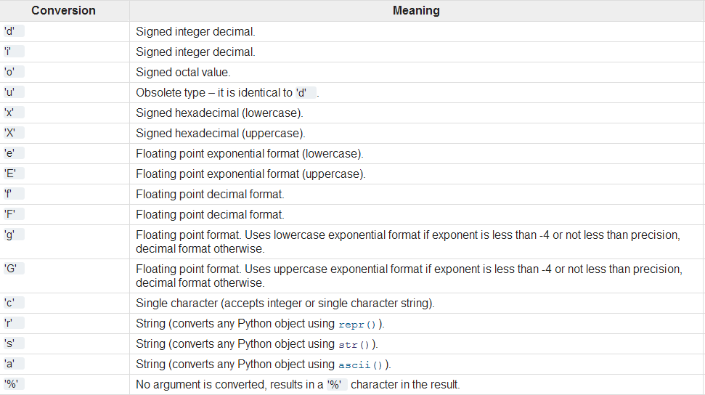
String Formatting (cont.)
 List of format symbols which can be used:
Source: https://docs.python.org/3.3/library/stdtypes.html#printf-style-string-formatting

Slide 38
Standard Input in Python
 Standard input in Python 3.3.x is performed with the
input function
input([prompt])
 If the prompt argument is present, it is displayed without a trailing newline.
 The function then reads a line from user input (terminated by the Enter key), and returns the string representation of that input.
 The string may need to be converted to the appropriate numeric type using int or float, before assigning to a variable.

Slide 39
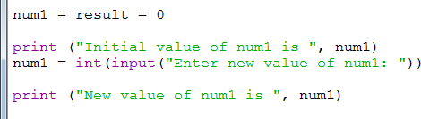
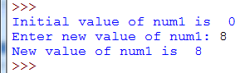
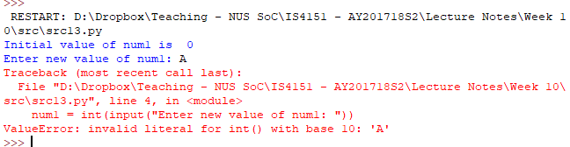
Standard Input in Python (cont.)
Successful input ☺
Unsuccessful input ☹ – We are expecting an integer but input is not a numeric value.

Slide 40
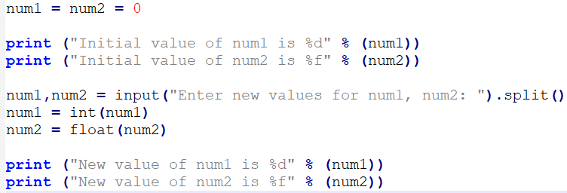
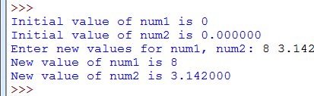
Standard Input in Python (cont.)
 In more complex cases, input can accept multiple values of different data types:

Slide 41
if Statement
 Conditional branching in Python is written with the if statement.
if EXPRESSION: TRUE ACTION
else:
FALSE ACTION
 if statement expression:
 Typically constructed from relational and/or logical operators with literal or variable of any primitive data types.
 Evaluates to either True or False.
 If True, executes TRUE ACTION.
 If False, executes FALSE ACTION.
 The else clause may be omitted if FALSE ACTION not required.

Slide 42
if Statement (cont.)
 Since there can be multiple statements for each action, they need to be indented to the right of the if and else headers.
 A header begins on a new line and ends with a colon (:)
 Indented statements that follow form the statement block.
 if statement serves two purposes:
 Alternative execution for two sets of actions:
 Sequential execution flows to if expression evaluation.
 If True, executes one set of actions, otherwise executes the other set of actions.

Slide 43
if Statement (cont.)
 Optional execution for one set of actions only:
 Sequential execution flows to if expression evaluation.
 Only one set of True actions is specified.
 If True executes the set of actions, otherwise skip over, i.e., no else
clause.

Slide 44
if Statement (cont.)
Begin
Begin
Yes
Expression True?
No
Yes
Expression True?
No
TRUE
Action(s)
FALSE
Action(s)
TRUE
Action(s)
End
End
Alternative Execution
Optional Execution

Slide 45
if statement (cont.)
x = 10
if x < 5:
print("Yeah")
x = 0
print("Done")
if x > 5:
print("Oops")
print("Done")

Slide 46
if-else statement
x = 10
if x < 5:
print("Yeah") x = 0
else:
print("Huh?") x = 2
print(x)

Slide 47
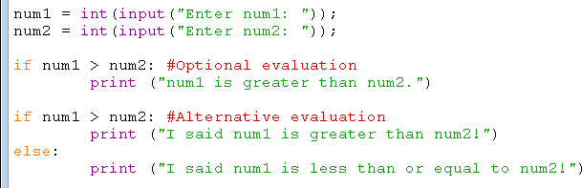
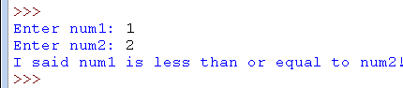
if and if-else Statement

Slide 48
if-elif Statement
 The if-elif statement (if-else if) allows us to perform alternative evaluation for more than two sets of actions. if SET 1 EXPRESSION:
SET 1 ACTION
elif SET 2 EXPRESSION:
SET 2 ACTION
elif SET 3 EXPRESSION:
SET 3 ACTION
else: # EXPRESSIONS for SET 1-3 evaluate
to FALSE
DEFAULT ACTION

Slide 49
if-elif Statement (cont.)
 The final else clause may be omitted if a default action is not required.
 In general, use elif for chained conditionals:
 When there are more than two possible actions.
 Cover all possible actions but without overlapping.
 Ensure that one and only one action is activated even though
there are multiple alternative actions.
 Still possible that none of the actions is triggered if the final else clause is omitted, i.e., no default action is specified.

Slide 50
if-elif Statement (cont.)
Begin
Yes
Set 1 Expression True?
No
Set 1 Action(s)
Yes
Set 2 Expression True?
No
Yes
Set 3 Expression True?
No
Set 2 Action(s)
Set 3 Action(s)
Default Action(s)
End

Slide 51
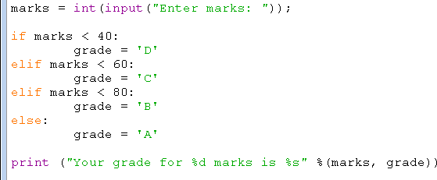
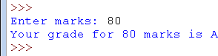
if-elif Statement (cont.)
Note that none of the expressions is overlapping

Slide 52
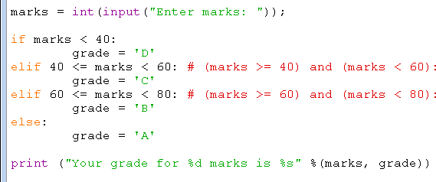
if-elif Statement (cont.)
Does this program behave exactly the same as src16.py?

Slide 53
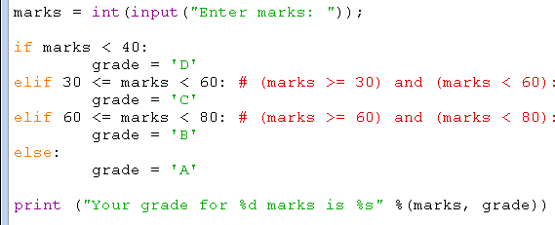
if-elif Statement (cont.)
Does this program behave exactly the same as src16.py and src17.py?

Slide 54
Nested if Statement
 An if statement may be nested within an outer if
statement.
 Two approaches to write nested if statement:
 Inner if statement may be nested within the if clause of the outer if statement:
 Achieve similar effect as the logical And operator.
 May be useful when the boolean expression is very complex.
 Inner if statement may be nested within the else clause of the outer if statement:
 Achieve similar effect as if-else if statements.
 No tangible benefit in most cases.

Slide 55
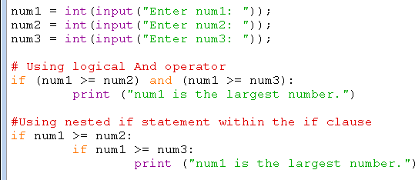
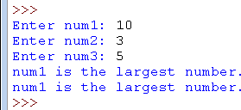
Nested if Statement (cont.)
Nested if within the if clause
Outer if
Inner if

Slide 56
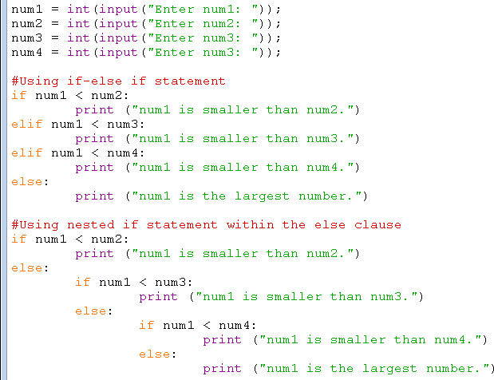
Nested if Statement (cont.)
Nested if within the else clause
Outer if
Inner
nested ifs

Slide 57
while Statement
 The while statement is used to implement iterative executions of statements in Python, a.k.a. while loop.
while EXPRESSION: ACTION
 The while expression is similar to the if expression
and evaluates to the Boolean value of True or False.
 The body of the while statement contains the action statements to be executed.
 The body must be indented to the right of the while header

Slide 58
while Statement (cont.)
 The while expression is always evaluated:
 At the beginning before the body is executed for the first time.
 Each time after the body has been executed.
 Execution of the body stops when the expression evaluates to False.
 It is possible that the body is never executed if the
expression evaluates to False in the beginning.
 It is also possible that the body executes forever if the expression always evaluates to True, i.e., an infinite loop.

Slide 59
while Statement (cont.)
Begin
Expression True?
No
Yes
Action(s)
End

Slide 60
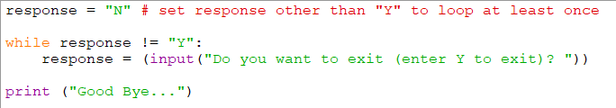
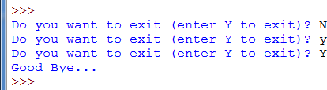
while Statement (cont.)

Slide 61
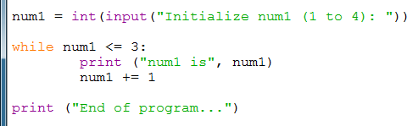
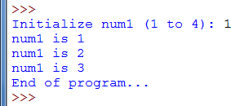
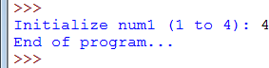
while Statement (cont.)
If num1 is initialized to 4, the while expression will evaluate to False in the beginning and the while body will never be executed.

Slide 62
for Statement
 The for statement allows the loop body to be executed for every value within a string (or any list of values).
 E.g., the following prints each letter of the string on a separate
line
for letter in 'Hello World': print(letter)
 The for statement can also be used for count-controlled
looping by specifying a list of values using range.
 E.g., the following sets i (counting variable) from 0 to 9 and prints each value of i.
for i in range(10):
print(i)

Slide 63
for Statement (cont.)
 Complete syntax:
for VARIABLE in SEQ:
ACTION
 VARIABLE takes on each value in SEQ to be executed within ACTION one at a time.
 ACTION must be indented to the right of the for
header
 SEQ can be a range function

Slide 64
range function
 range(start, stop[, step])
 integer values from start to stop excluding, in increments of
step
 start and step are optional, with the default being 0 and 1
respectively
 range(n)
 integer values from 0 to one less than n, increment by 1
 range(start, stop)
 integer values from start to one less than stop, increment by
1.

Slide 65
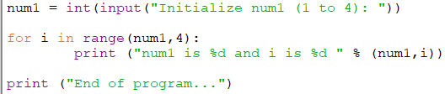
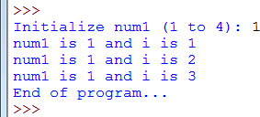
for Statement (cont.)

Slide 66
Nested Loops
 Any number and combination of the followings may be nested within one another:
 while statement
 for statement
 A typical example involves nested for statements:
 Use multiple counting variables.
 One distinct counting variable in each for statement.
 Inner for statements use the outer for statements’ counting variables for some purposes.

Slide 67
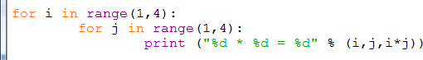
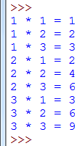
Nested Loops (cont.)
Inner nested for
Outer for
In this simple example, we use two counting variables: i for the outer for statement and j for the inner for statement.

Slide 68
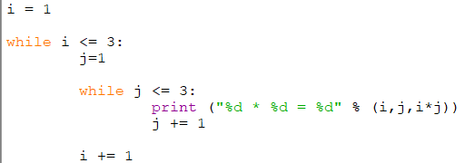
Nested Loops (cont.)
 Another typical example involves nested while statements:

Slide 69
break and continue Statements
 break statement:
 Causes an immediate termination of and exit from the
enclosing while or for loop.
 Can be used to force an exit from an infinite loop.
 continue statement:
 Causes an immediate termination in the body of the enclosing
loop but does NOT exit.
 Instead of exiting the enclosing loop, control flow proceeds to the top of the loop where
 the loop EXPRESSION is evaluated (while loop),
 the control variable takes on the next value in the list (for loop).

Slide 70
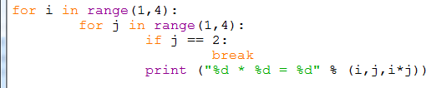

break and continue Statements (cont.)

Slide 71

break and continue Statements (cont.)
Infinite while loop

Slide 72


break and continue Statements (cont.)

Slide 73
Python Data Structure
A simple variable contains a single value.
Python supports several types of data structure:
list
set
strings
tuples
dictionary
Each type of data structure can:
Contain several data value simultaneously.
The data values can be of different types.

Slide 74
Python Data Structure (cont.)
Set:
A set is an unordered collection with unique elements.
Mainly use for membership testing and eliminating duplicate entries.
Also support mathematical operations like union, intersection, difference, and symmetric difference.
Set does not support indexing.
E.g., set = {'apple', 'orange', 'pear', 'banana', 'apple'}

Slide 75


Python Data Structure (cont.)

Slide 76
Python Data Structure (cont.)
Dictionary:
A.k.a. dicts
Each particular value is associated with a particular label known as a key.
Data in a dictionary does not have any internal order.
There is only the definitions of key/value pairs.
E.g., dict = {'name': 'William', 'age': 25, 'city': 'London'}
The name of the associated key is used to access a specific value.
The for-in loop can be used to iterate all key/value pairs using the items() function of the dictionary.

Slide 77
Python Data Structure (cont.)
List:
Contains a number of objects in a precise order to form a sequence.
Elements can be added to, or removed from, the sequence.
Each item is identified by a number corresponding to the order of the sequence known as the index.
The index is zero-based and so the first item is referenced by the index number 0.
E.g., list = [1,2,3,4]

Slide 78


Python Data Structure (cont.)

Slide 79


Python Data Structure (cont.)
Multidimensional list (or array):
To represent a two dimensional data table or dataset with rows and columns in Python, we can use a two dimensional list.
Each cell or element is referenced by two zero-based index numbers, one for the row and another for the column.

Slide 80


Python Data Structure (cont.)
Multidimensional dictionary:
To represent a two dimensional data table or dataset with meaningful labels or keys, we can use a two dimensional dictionary.

Slide 81
Python Data Structure (cont.)
A dictionary is more useful compared to a set for most general purposes.
We can think of a list as a dictionary in which the keys are zero-based index numbers.
A string is essentially a list of characters.
A relational database table can be represented by a two dimensional list but it is NOT adequate. Why?
Representing a relational database table with a two dimensional dictionary seems more useful.

Slide 82
Learning Objectives
At the end of this lecture, you should understand:
How to use Python’s SciPy data science libraries to perform common data analytics tasks easily:
Basic Numerical Processing using NumPy.
Data Preparation and Exploration using Pandas.
Data Visualisation using Matplotlib.
Machine Learning using Scikit Learn.
How to go about performing machine learning in Python.

Slide 83





Overview of SciPy
SciPy (pronounced “Sigh Pie”) is a Python-based ecosystem of open-source software for mathematics, science, and engineering.
Some of the core packages include:
NumPy – Base N-dimensional array package.
SciPy library – Fundamental library for scientific computing.
Matplotlib – Comprehensive 2D Plotting.
Pandas – Data structures & analysis.

Slide 84
Overview of the NumPy Library
The built-in tools provided by the standard Python library may be too simple or inadequate for data analysis calculation.
NumPy is the basic package for scientific computing in Python.
It forms the basis for many other mathematical and scientific Python packages.
NumPy library is based on one main object, i.e., ndarray, which stands for N-dimensional array:
ndarray is a multidimensional homogeneous array with a predetermined number of items.
All items are of the same type and the same size.

Slide 85

Overview of the NumPy Library (cont.)
NumPy library operates on the ndarray object to support calculation of multidimensional arrays and large arrays.

Slide 86
More about the ndarray Object
The number of the dimensions and items in an array is defined by its shape:
The size of each dimension is specified by a tuple of N-positive integers.
The dimensions are defined as axes and the number of axes is the rank.
The data type is specified by the dtype attribute.
The array() function is used to define a new ndarray by passing in a Python list containing the elements to be included.

Slide 87

More about the ndarray Object (cont.)
Other important attributes of the ndarray object:
ndim – get the number of axes or rank.
size – Length of the array
shape – Shape of the array.

Slide 88

More about the ndarray Object (cont.)
NumPy ndarray can contain a wide variety of data types including string:

Slide 89

More about the ndarray Object (cont.)
NumPy supports the data types listed in the table below:

Slide 90

Basic Operations on ndarray Object
Arithmetic operations can be performed with arithmetic operators between an array and a scalar:
Common operators include addition or multiplication.
Operations are element-wise, i.e., the operators are applied only between corresponding elements that occupy the same position.
The end result will be a new array containing the results in the same location of the operands.
Can be applied to multidimensional array too.

Slide 91

Basic Operations on ndarray Object (cont.)

Slide 92

Basic Operations on ndarray Object (cont.)
Matrix product:
Matrix product that applies that applies to two arrays can be done with the dot() function.

Slide 93

Basic Operations on ndarray Object (cont.)

Slide 94
Basic Operations on ndarray Object (cont.)
Indexing and iterating an array:
Array indexing uses the square brackets (‘[]’) to index the elements of the array so that each element can be individually referenced.
Indexing allows the users to extract a value, select items or even assign new value to an element in the array.
When an array is newly created, an appropriate scale index is automatically created.
We can use the for statement to iterate an N-dimensional array.
When N > 1, we can use multiple nested for statements.

Slide 95



Basic Operations on ndarray Object (cont.)

Slide 96

Basic Operations on ndarray Object (cont.)

Slide 97

Overview of the Panda Library
Panda is an open source Python library for performing highly specialised data analysis.
It provides a single library for data analysts to easily process data, extract data and manipulate data, i.e., data preparation.
Panda is built upon the NumPy library.
The standard data structures provided by Python and the ndarray provided by NumPy are not ideal for working with relational data or labelled data.

Slide 98
Overview of the Panda Library (cont.)
Panda fills this important gap by providing two new data structures, namely Series and DataFrame.
Series and DataFrame provide data analysts with the data manipulation capability equivalent to SQL-based relational database within Python.

Slide 99

Series
Series is the Panda object for representing one-dimensional data structures:
Similar to an array but with some additional features.
Internal structure is relatively easy and consists of two arrays associated with each other:
The main array holds the data (any NumPy type).
Each piece of data or element is associated with a label.
The label is contained within the other array.

Slide 100

Creating a Series
To create a new Series:
Call the Series() constructor and pass in the array containing the values to be included in the series.
By default, the label is a zero-based index number.
So the left column is a series of labels and the right column is the corresponding values.

Slide 101

Creating a Series (cont.)
But it is preferable to create Series using meaningful labels:
Can distinguish and identify each item regardless of the order in which they were inserted into the Series.
This can be done by including the index option and assigning an array of strings containing the labels.

Slide 102

Selecting Elements in a Series
Internal elements in the Series can be selected as:
Ordinary numpy array s[2]
Label corresponding to the position of the index s[‘b’]
Also possible to select multiple items.

Slide 103


Selecting Elements in a Series (cont.)
New value can be assigned to individual elements using the assignment operator:
Individual elements can be filtered by their value using NumPy filter syntax:

Slide 104
Basic Operations on Series
We can perform various operations and mathematical functions that are applicable to NumPy arrays to Pandas Series:

Slide 105

Basic Operations on Series (cont.)
Evaluating values within a Series provides information on:
What are the samples contained – unique()
Counting duplicate values – value_counts()
Determine whether a value is present or not – isin()

Slide 106

Basic Operations on Series (cont.)
Series can be created from a dict (dictionary) object as they are actually very similar in the general structure.
Finally, since we can perform arithmetic operation between a Series and a scalar value, we can do that between two Series too.

Slide 107

DataFrame
DataFrame is a tabular data structure very similar to a spreadsheet or relational database table.
It extends the Series to multiple dimensions.
DataFrame is essentially an ordered collection of columns, each of which can contain a value of different type.

Slide 108
DataFrame (cont.)
Recall that a Series has an index array containing labels associated with each element.
A DataFrame has two index arrays:
The first array is associated with the rows and serves a similar function as the index array in a Series.
In fact, each label in the first array is associated with all the values in the row → Think of this as the row header in a spreadsheet or primary key in a relational database table.
The second array contains a series of labels, each associated with a particular column → Think of this as the column header in a spreadsheet or column name in a relational database table.

Slide 109
DataFrame (cont.)
Another way to look at a DataFrame is to think of it as a dictionary of Series:
The keys are the column names.
The values are the Series.
Furthermore, all elements of each Series are mapped according to an array of labels called the index.

Slide 110
Defining a DataFrame
The most common way to define a DataFrame is to pass a dict object to the DataFrame() constructor:
The dict object contains a key for each column to be defined together with an array of value.
This approach is quite similar to how we define a Series only that now we are essentially defining multiple Series objects to make up the DataFrame.

Slide 111

Defining a DataFrame (cont.)

Slide 112
Selecting Elements in a DataFrame
We can obtain the name of all the columns and the list of indexes of the DataFrame object using its columns and index attributes, respectively.
The entire set of data in the DataFrame can be retrieved using the values attribute.
To select the contents of a column, we can use the column name as a label or use the column name as an attribute of the DataFrame.
To select the contents of a row, we can use the ix attribute with the required index value.

Slide 113

Selecting Elements in a DataFrame (cont.)
To select the content of a cell, we combine the ix attribute with the required column name.

Slide 114

Selecting Elements in a DataFrame (cont.)
We can assign new value to each cell with the assignment operator and the loc attribute of the DataFrame.

Slide 115

Basic Operations on DataFrame
Arithmetic operations can be performed between two DataFrame objects using the flexible arithmetic methods:
add()
sub()
div()
mul()

Slide 116

Basic Operations on DataFrame (cont.)
Statistic functions can be applied on the DataFrame:
sum()
mean()
describe()

Slide 117

Importing Data into DataFrame
We can read data file in various format into a DataFrame object.
The content of a CSV file can be read in with the read_csv() function and converted to a DataFrame object.
The index_col attribute of read_csv() can be used to designated the row header or primary key.
We can read other formats such as Excel, SQL, JSON and STATA.

Slide 118
Manipulating Columns in DataFrame
Adding columns:
A new column can be added by setting the new column name to be equal to an initial/default value, e.g., 0.
We can also initialize the new column to the null value using the NumPy special value np.nan.
Dropping columns:
We can drop a column using the drop() function.
Need to specify the column key and set the axis attribute to 1.
Setting axis to 0 is used to drop a row.

Slide 119

Manipulating Columns in DataFrame (cont.)

Slide 120

Overview of the Matplotlib Library
Data visualisation is an important part of data analytics as correct and efficient representation of data can improve understanding of the analysis.
Matplotlib is a Python library specialising in the development of two-dimensional charts (including 3D charts).
Key features:
Simplicity of usage.
Gradual development and interactive data visualisation.
Good control over graphics elements.
Exportable in many formats such as PNG, SVG and EPS.

Slide 121
Matplotlib Architecture
Matplotlib provides a set of functions and tools that allow the representation and manipulation of a Figure (the main object) and its associated internal objects.
Other than graphics, Matplotlib also handles the events and graphics animation.
Thus, Matplotlib can produce interactive charts that can respond to events triggered by keyboard or mouse movement.
The architecture of Matplotlib is structured into three layers with unidirectional communication:
Each layer can communicate with the underlying layer only.

Slide 122

Matplotlib Architecture (cont.)
Backend layer – Matplotlib API and a set of classes to represent the graphic elements.
Artist layer – An intermediate layer representing all the elements that make up a chart, e.g., title, axis, labels, markers, etc.
Scripting layer – Consists of the pyplot interface for actual data calculation, analysis and visualisation.

Slide 123

Matplotlib Architecture (cont.)
Each instance of a chart corresponds to an instance of Artist structured in a hierarchy

Slide 124

Matplotlib Architecture (cont.)
The three main artist objects in the hierarchy of the Artist layer.

Slide 125

pyplot
The pyplot module is a collection of command-style functions that allow the data analyst to operate or make changes to the Figure.
E.g., Create a new Figure.
A simple interactive chart can be created using the pyplot object’s plot() function.
The plot() function uses a default configuration that does not have title, axis label, legend, etc.

Slide 126


Pyplot (cont.)
The default configuration can be changed to obtain the desired chart.

Slide 127

Matplotlib and NumPy
Matplotlib is based on NumPy.
NumPy arrays can be directly entered as input data.

Slide 128

Machine Learning with Scikit-Learn
Scikit-Learn is a Python module that integrates many machine learning algorithms.
In this short introduction to Scikit-Learn, we will look at an example of supervised learning with the Iris Flower dataset.

Slide 129


The Iris Flower Dataset
This dataset set contains data from three different species of iris (Iris silky, virginica Iris and Iris versicolor).
The variables include the length and width of the sepals, and the length and width of the petals.
This dataset is widely used for classification problems.
150 observations with 4 independent attributes and one target attribute.

Slide 130

Exploring the Iris Flower Dataset
Scatterplot of sepal sizes.
Scatterplot of petal sizes.
K-Nearest Neighbors Classifier (k-NN).
What is k-NN?
Decision boundaries on a 2D scatterplot describing the petal sizes.
If k=3, the test sample green circle will be classified as the class associated with the red triangle.

Slide 131
Exploratory Data Analysis

Slide 132
Learning Objectives
At the end of this lecture, you should understand:
What is Data Analytics
What is Descriptive Analytics?
Exploratory Data Analysis
Data Visualisation
Descriptive Statistical Measures:
Measures of Location
Measures of Dispersion
Measures of Shape
Measures of Association

Slide 133
What is Data Analytics?
Data analytics:
Use data, computing technology, statistical analysis, quantitative methods, and mathematical or computer-based models.
Gain improved insights about business operations and make better, fact-based decisions.
Scope of data analytics:
Descriptive analytics – Uses data to understand past and present.
Predictive analytics – Analyses past performance.
Prescriptive analytics – Uses optimisation techniques.

Slide 134
What is Data Analytics? (cont.)
Hypothetical example of data analytics in a typical business scenario:
Retail markdown decisions – Most department stores clear seasonal inventory by reducing prices.
The question is – When to reduce the price and by how much?
Descriptive analytics – Examine historical data for similar products (prices, units sold, advertising, …)
Predictive analytics – Predict sales based on price.
Prescriptive analytics – Find the best sets of pricing and advertising to maximise sales revenue.

Slide 135
What is Data Analytics? (cont.)
Real-world actual example of data analytics:
Harrah’s Entertainment – Harrah’s owns numerous hotels and casinos
Uses predictive analytics to:
Forecast demand for rooms.
Segment customers by gaming activities.
Uses prescriptive analytics to:
Set room rates.
Allocate rooms.
Offer perks and rewards to customers.

Slide 136
What is Data Mining?
Data mining:
Refers to the process of finding anomalies, patterns and correlations within large data sets to predict outcomes.
Most prevalent form of predictive analytics in use in modern business environment.
Data in data mining:
A collection of facts usually obtained as the result of experiences, observations or experiments.
May consist of numbers, words and images.
Lowest level of abstraction (from which information and knowledge are derived).

Slide 137

What is Data Mining?
Taxonomy of data:

Slide 138
Categorical Data
Categorical Data:
Represent the labels of multiple classes used to divide a variable into specific groups.
Examples:
Race, sex, age group and educational level.
Certain variables such as age group and educational level may be represented in numerical format using their exact values.
Often more informative to categorise them into small number of ordered classes.
Age Group | Age Range
Primary School Students | 7 – 12
Secondary School Students | 13 – 16
Pre-tertiary Students | 17 – 19
Tertiary Students | >= 20

Slide 139
Categorical Data (cont.)
Discrete in nature since there are a finite number of values with no continuum between them.
Nominal data:
Categorical variables without natural ordering.
E.g., Marital status can be categorized into (1) single, (2) married and (3) divorced.
Nominal data can be represented as either:
Binomial values with two possible values, e.g., yes/no or true/false.
Multinomial values with three or more possible values, e.g., marital status or ethnicity (white/black/Latino/Asian).

Slide 140
Categorical Data (cont.)
Ordinal data:
Categorical variables that lend themselves to natural ordering.
I.e., the codes assigned to objects represent the rank order among them.
But it makes no sense to calculate the differences or ratios between values.
Examples:
Credit score can be categorized as (1) low, (2) medium and (3) high.
Education level can be categorized as (1) high school, (2) college and (3) graduate school.
Age group.
The additional rank-order information is useful in certain data mining algorithms for building a better model.

Slide 141
Numerical Data
Numerical data:
Represent the numerical values of specific variables.
Examples:
Age, number of children, total household income (in SGD), travel distance (in kilometers) and temperature (in Celsius).
Numerical values can be integer (whole number only) or real (including the fractional number).
Continuous in nature since the variable contains continuous measures on a specific scale that allows insertion of interim value.
Discrete variable represents finite, countable data.
Continuous variable represents scalable measures and may contain infinite number of fractional values.

Slide 142
Numerical Data (cont.)
Interval data:
Numerical variables that are measured on interval scales.
Example:
Temperature on the Celsius scale is 1/100 of the difference between the melting temperature and boiling temperature of water.
There is no notion of absolute zero value.
Ratio data:
Numerical variables that are measured on ratio scales.
Examples:
Common measurements in physical science and engineering such as mass, length and time.
A ratio scale has a non-arbitrary zero value defined.
Kelvin temperature scale has a non-arbitrary zero value of absolute zero, which is equal to -273.15 degrees Celsius.

Slide 143
Other Data Types
Data mining may involve many other data types:
Unstructured text, image and audio.
These data types need to be converted into some form of categorical or numerical representation before they can be processed by data mining algorithms.
Data may also be classified as:
Static.
Dynamic, i.e., temporal or time series.

Slide 144
Data Type and Data Mining
Some data mining methods are particular about the data types that they can handle.
Providing incompatible data types may lead to:
Incorrect models.
Halting of the model development process.
Examples:
Neural networks, support vector machines and logistic regression require numerical variables:
Nominal or ordinal variables are converted into numerical representations using 1-of-N pseudo variables.
Categorical variable with N unique values can be transformed into N pseudo variables with binary values – 1 or 0.

Slide 145
Data Type and Data Mining (cont.)
ID3 (a class decision tree algorithm) and rough sets (a relatively new rule induction algorithm) require categorical variables:
Numeric variables are discretize into categorical representations.
Multiple regression with categorical predictor variables:
Binomial categorical variable:
Simply represent the variable with a binary value – 1 or 0.
Multinomial categorical variable:
Need to perform the process of dummy coding.
A multinomial variable with k possible values may be represented by k-1 binomial variables each coded with a binary value – 1 or 0.
Similar concept to 1-of-N pseudo variables.

Slide 146
Data Type and Data Mining (cont.)
The good news is:
Some, but not all, software tools accepts a mix of numeric and nominal variables.
Internally make the necessary conversion before processing the data.
For learning purpose, you need to know when and how to use the correct data types.

Slide 147

Tukey’s Exploratory Data Analysis
Exploratory Data Analysis (EDA) was first proposed by John Tukey.
EDA is more of a mindset for analysis rather than an explicit set of techniques and models.
EDA emphasises data observation, visualisation, and the careful application of technique to make sense of data.
EDA is NOT about fitting data into analytical model BUT rather about fitting a model to the data.

Slide 148
Why Study Exploratory Data Analysis?
Visually examining data to understand patterns and trends:
Raw data should be examined to learn the trends and patterns over time, and between dimensions in the data.
Visual examination can help to frame what analytical methods are possible to apply to the digital data.
Using the best possible methods to gain insights into not just the data, but what the data is saying:
Going beyond the details of data to understand the data is saying in the context of answering our question.

Slide 149
Why Study Exploratory Data Analysis? (cont.)
Identifying the best performing variables and model for the data:
There are so many big data, how do we decide what is useful?
EDA helps ascertain what variables are influential and important.
Detecting anomalous and suspicious outlier data:
Outliers and anomalies in the data may be important, highly relevant, and meaningful to the business.
Can also be just random noise that can be ignored and excluded from analytical consideration.

Slide 150
Why Study Exploratory Data Analysis? (cont.)
Testing hypothesis and assumptions:
Using insights derived from data to create hypotheses.
Test hypothesis-driven changes.
The gist is to use data to test hypotheses.
Finding and applying the best possible model to fit the data:
Predictive modelling and analysis requires an EDA approach that is more focused on the data rather than the model.

Slide 151
General Process of Exploratory Data Analysis
Identify the key dimensions and metrics of the dataset.
Use analytical software to visualise the data using the techniques that we will review in this lecture.
Apply the appropriate statistical model to generate value.
The general idea is to:
Use tool and pattern recognition abilities to observe the data relationships and unusual data movements.
By visually examining and exploring the data, it becomes possible to focus the approach to the analysis work.

Slide 152
Data Quality Report
To ascertain how good a dataset is, we can evaluate the dataset with a data quality report.
Use Panda’s DataFrame to calculate the required statistics.
.

Slide 153


Data Visualisation – Line Plot
To create a simple line plot, we can use DataFrame.plot(), which relies on matplotlib:
By default, you will get a line plot.

Slide 154

Data Visualisation – Line Plot (cont.)
To customise the line plot, we need to use matplotlib directly:

Slide 155

Data Visualisation – Bar Plot
To create a bar plot, we need to set the kind attribute in DataFrame.plot() to “bar”.
See the sample script in src04.py.
By default, the index of the DataFrame is a zero-based number and thus x-axis are the numbers 0 to 4.
We can change the index of the DataFrame to the Name column and replot the bar plot.

Slide 156


Data Visualisation – Box Plot
A box plot can be created using DataFrame.boxplot() and specifying the required column, in this case, “Grade”.
src06.py

Slide 157
Data Visualisation – Box Plot (cont.)
A box plot is a method for graphically depicting groups of numerical data through their quartiles:
The box extends from the Q1 to Q3 quartile values of the data, with a line at the median (Q2).
The whiskers extend from the edges of box to show the range of the data.
The position of the whiskers can represent several values:
The lowest datum still within 1.5 IQR of the lower quartile, and the highest datum still within 1.5 IQR of the upper quartile.
IQR = Q3 – Q1.
Outlier points are those past the end of the whiskers.
But if there are no outliers, then the whiskers show the minimum and maximum values of the data.

Slide 158


Data Visualisation – Box Plot (cont.)
IQR = 18
Outliers will fall outside ±1.5 * IQR from Q1 and Q3, i.e., 50 and 122
The min and max values are within this range.
In this example, the whiskers shows the minimum and maximum values since there is no outlier.

Slide 159


Data Visualisation – Box Plot(cont.)
Adding one extra observation with a Grade of 130 will lead to an outlier
IQR = 20.75
Outliers will fall outside ±1.5 * IQR from Q1 and Q3, i.e., 46.125 and 129.125
The max value is outside this range.
In this example, the whiskers shows the lowest datum still within 1.5 IQR of the lower quartile (i.e., 76), and the highest datum still within 1.5 IQR of the upper quartile (i.e., 99).

Slide 160

Data Visualisation – Box Plot (cont.)
We can create a box plot with categorisation, in this case by Gender.
We can also adjust the y-axis so that it runs from 0 to 100.

Slide 161


Data Visualisation – Box Plot (cont.)
Box plots with categorisation showing. The one on the right has the y-axis limit set to 0-100.

Slide 162


Data Visualisation – Histogram
A box plot can be created using DataFrame.hist()
By default, the histograms for the columns with numeric values will be generated.
To generate a histogram for a particular column, you can specify the name of the required column in the column attribute, e.g., df.hist(column=‘hours’).

Slide 163

Data Visualisation – Histogram (cont.)
We can also generated histogram for a numerical column grouped by another column, typically a categorical column, using the by attribute.

Slide 164


Data Visualisation – Pie Chart
A box plot can be created using pyplot.pie().
Customisations can be made to the pie chart to make it more meaningful.

Slide 165


Data Visualisation – Scatter Plot
A scatter plot can be created using pyplot.scatter().

Slide 166
More About Exploratory Data Analysis
Three main phases:
Univariate analysis – Investigate the properties of each single variable in the dataset.
Bivariate analysis:
Measure the intensity of the relationship existing between pairs of variables.
For supervised learning models, focus is on the relationships between the predictive variables and target variable.
Multivariate analysis – Investigate the relationships holding within a subset of variables.

Slide 167
More About Exploratory Data Analysis (cont.)
Variable A
Target Variable
Visual illustration of the differences among the three phases:
Variable B
Target Variable
Important for supervised learning models
Variable A
Variable C
Target Variable
Variable B
Variable A
Variable B
Variable A
Variable C
Variable A
Variable C
Target Variable
Variable B
Variable C
Variable B
Variable C
Univariate
Bivariate
Multivariate

Slide 168
Univariate Analysis
Study the behavior of each variable as an entity independent of other variables in the dataset.
Three characteristics that are of interest:
Location – Tendency of the values of a given variable to arrange themselves around a specific central value.
Dispersion – Propensity of the variable to assume a more or less wide range of values.
Underlying probability distribution.
Objectives of univariate analysis:
Verify validity of assumptions regarding variable distribution:
E.g., Values of a variable are exactly or approximately normal.
Regression assumes that variables have normal distributions.

Slide 169
Univariate Analysis (cont.)
Verify the information content of each variable:
E.g., A variable that assumes the same value for 95% of the available records may be considered fairly constant for practical purposes.
The information it provides is of little value.
Identifying outliers – Anomalies and non-standard values.
For the remaining discussion, let’s suppose the dataset contains m records and denote by the generic variable being analyzed:
The subscript j will be suppressed for clarity.
The vector of m records corresponding to will simply be denoted by:

Slide 170
Measures of Location
Mean:
Sample arithmetic mean is defined as:
The sum of the differences between each value and the sample mean, i.e., the deviation or spread, is equal to 0.
It is also the value c that minimises the sum of squared deviations:

Slide 171
Measures of Location (cont.)
Weighted sample mean:
At times, each value is found to be associated with a numerical coefficient , i.e., the weight of that value.
Example:
is the unit sale price of the ith shipping lot consisting of product units.
The average sale price would be the weighted sample mean.

Slide 172
Measures of Location (cont.)
Median:
Suppose are m observations arranged in a non-decreasing way.
If m is an odd number, the median is the observation occupying position , i.e., .
If m is an even number, the median is the middle point in the interval between the observations of position and .
Example of m as odd number:
-2, 0, 5, 7, 10
Median is 5.
Example of m as even number:
50, 85, 100, 102, 110, 200
Median is , i.e., using the 3rd and 4th observations.

Slide 173

Measures of Location (cont.)
Mode:
The value that corresponds to the peak of the empirical density curve for the variable a.
The value that appears most often in the dataset for variable a.
If the empirical density curve has been calculated by partitioning continuous values into intervals, each value of the interval that corresponds to the maximum empirical frequency is the mode.
(Source: Science Buddies)

Slide 174
Measures of Location (cont.)
Midrange:
The midpoint in the interval between the minimum value and the maximum value.
Not robust with respect to extreme values, i.e., presence of outliers (just like the mean).
Example:
50, 85, 100, 102, 110, 200

Slide 175
Measures of Location (cont.)
Geometric mean:
m^{th} root of the product of the m observations of the variable a.
Example (Source: University of Toronto Mathematics Network):
Suppose you have an investment which earns 10% the first year, 60% the second year, and 20% the third year. What is its average rate of return?
After one year, $1 investment becomes $1.10.
After two years, this investment becomes (1.10 + 0.6×1.10) = $1.76.
After three years, we have (1.76 + 0.2×1.76) = $2.122.
By what constant factor would your investment need to be multiplied by each year in order to achieve the same effect as multiplying by 1.10 one year, 1.60 the next, and 1.20 the third?

Slide 176
Measures of Location (cont.)
The average rate of return is about 28% (not 30% which is what the arithmetic mean of 10%, 60% and 20% would return).
Arithmetic mean is calculated for observations which are independent of each other.
Geometric mean is used to calculate mean for observations that are dependent on each other.

Slide 177
Measures of Dispersion
Location measures provide an indication of the central part of the observed values for a numerical variable.
Need measures of dispersion to represent the variability expressed by the observations w.r.t. the central value.
The two empirical density curves below have mean, median and mode equal to 50.

Slide 178
Measures of Dispersion (cont.)
In most applications, it is desirable to have data with small dispersion (left).
E.g., In manufacturing process, a wide variation in a critical measure might point to an undesirable level of defective items.
In some applications, a higher dispersion may be desired, for example, for the purpose of classification/discriminating between classes.
E.g., In the case of test results intended to discriminate between the abilities of candidates, it is desirable to have a fairly wide spectrum of values.

Slide 179
Measures of Dispersion (cont.)
Range:
The simplest measure of dispersion.
Useful to identify the interval in which the values of a variable fall.
Unable to catch the actual dispersion of the values.
The densities below have the same range but the dispersion for the density on the right is greater than that on the left.
5 6 7 8 9 10
5 6 7 8 9 10

Slide 180
Measures of Dispersion (cont.)
Mean absolute deviation (MAD):
The deviation, or spread, of a value is defined as the signed difference from the sample arithmetic mean:
and
MAD is a measure of dispersion of observations around their sample mean through the sum of the absolute values of the spreads:
The lower the MAD, the more the values fall in proximity of their sample mean and the lower the dispersion is.

Slide 181
Measures of Dispersion (cont.)
Variance:
More widely used than MAD.
Sample variance is defined as:
A lower sample variance implies a lower dispersion of the values around the sample mean.
As size of the sample increases:
Sample mean approximates the population mean .
Sample variance approximates the population variance .

Slide 182

Measures of Dispersion (cont.)
To bring the measure of dispersion back to the original scale in which the observations are expressed, the sample standard deviation is defined as:

Slide 183

Measures of Dispersion (cont.)
Normal distribution:
If the distribution of variable a is normal or approximately normal:
The interval contains approximately 68% of the observed values.
The interval contains approximately 95% of the observed values.
The interval contains approximately 100% of the observed values.
Values that falls outside can
be considered as suspicious outliers.

Slide 184
Measures of Dispersion (cont.)
Coefficient of variation:
Defined as the ratio between the sample standard deviation and the sample mean, expressed in percentage terms as:
Provides a relative measure of dispersion.
Used to compare two or more groups of data usually obtained from different distributions.

Slide 185
Relative Measures of Dispersion
Relative measures of dispersion are used to examine the localisation of a value w.r.t. to other values in the sample.
Quantiles:
Suppose we arranged the m values of a variable a in non-decreasing order.
Given any value p, with , the p-order quantile is the value such that pm observations will fall on the left of and the remaining (1-p)m on its right.
Sometimes, p quantiles are called 100 p^{th} percentiles.
0.5-order quantile coincides with the median.
= 0.25-order quantile, also called lower quartile.
= 0.75-order quantile, also called upper quartile.

Slide 186

Relative Measures of Dispersion (cont.)
Interquartile range (IQR) is defined as the difference between the upper and lower quartiles:
(Source: http://www.cdc.gov/osels/scientific_edu/ss1978/Lesson2/Section7.html)

Slide 187

Identification of Outliers for Numerical Variables
z-index:
Calculated as
Identify outliers in most cases.
Data values which are outside 3-standard deviations from the sample mean are considered to be suspicious:
– Suspicious
– Highly suspicious
Box plots or box-and-whisker plots:
Median and the lower and upper quartiles are represented on the axis where the observations are placed:
Length of the box represents the interquartile range (the distance between the 25th and the 75th percentiles).
$$z_{i}=\frac{x_{i}−\overline{x}}{σ}$$

Slide 188
Identification of Outliers for Numerical Variables (cont.)
Dot in the box interior represents the mean.
Horizontal line in the box interior represents the median.
Vertical lines issuing from the box extend to the minimum and maximum values of the analysis variable.
At the end of these lines are the whiskers.
An observation is identified as an outlier if it falls outside four thresholds:
External lower edge =
Internal lower edge =
Internal upper edge =
External upper edge =

Slide 189

Measures of Shape
Skewness refers to the lack of symmetry in the distribution of the data values.
Refers to the empirical density of empirical relative frequencies that is calculated by dividing the raw frequency by m, i.e., the number of records.
Negatively (left) skewed
Mean < Median < Mode
Positively (right) skewed
Mode < Median < Mean

Slide 190
Measures of Shape (cont.)
An index of asymmetric, the sample skewness, based on the third sample moment may be used measure shape:
The third sample moment is defined as:
The sample skewness is defined as:
Sample skewness is interpreted as follow:
Density curve is symmetric then
Density curve is skewed to the right then
Density curve is skewed to the left then

Slide 191
Measures of Shape (cont.)
Kurtosis:
The kurtosis index expresses the level of approximation of an empirical density to the normal curve using the fourth sample moment defined as:
The kurtosis is defined as:

Slide 192

Analysis of the Empirical Density (cont.)
Kurtosis is interpreted as follow:
If the empirical density perfectly fits a normal density then
Empirical density is hyponormal, it shows greater dispersion than the normal density, i.e., assigns lower frequencies to values close to mean
Empirical density is hypernormal, it shows lower dispersion than the normal density, i.e., assigns higher frequencies to values close to mean
(Source: Vercellis 2009, pp. 133)

Slide 193
Descriptive Statistics
DataFrame.describe() can generate the descriptive statistics for each Series (i.e., column) in the DataFrame:
This works only for numeric columns.
Summarise the central tendency, dispersion and shape of a dataset’s distribution, excluding missing values.
DataFrame.skew() can generate the skewness index.
DataFrame.kurtosis() can generate the kurtosis.
We have discussed histogram earlier.
The empirical density can be generated with DataFrame.plot.density().

Slide 194



Descriptive Statistics (cont.)
Empirical density curve for hours

Slide 195
Measures of Association
Summary indicators may be used to express the nature and intensity of relationship between numerical variables.
Covariance:
Given a pair of variables and , let and be the corresponding sample means.
Sample covariance is defined as:
Concordance:
Values of greater(lower) than mean are associated with
values of also greater(lower) than mean .

Slide 196
Measures of Association (cont.)
Two elements of the product in the summation agree in sign and will provide a positive contribution to the sum.
Discordance:
Values of greater(lower) than mean are associated with
values of lower(greater) than mean .
Two elements of the product in the summation will not agree in sign and will provide a negative contribution to the sum.
Positive(negative) covariance values indicate that variables and are concordant(discordant).
Limitation of covariance:
Covariance is usually a number ranging on a variable scale and thus it is inadequate to assess the intensity of the relationship.
Correlation is more useful.

Slide 197
Measures of Association (cont.)
Correlation:
Correlation refers to the strength and direction of the relationship between two numerical variables.
Interpreting correlation value:
1 means strong correlation in the positive direction.
-1 means a strong correlation in the negative direction.
0 means no correlation.
Some machine learning algorithms do not work optimally due to multicollinearity:
Multicollinearity refers to the presence of correlations among the independent variables.
Important to review all pair-wise correlations among the independent variables.

Slide 198
Measures of Association (cont.)
Pearson R Correlation:
Most common measure of the relationships between two numerical variables which are linearly related and seem to be normally distributed.
Defined as:
where and are sample standard deviations of and
always lies in the interval [-1,1].
represents a relative index expressing the intensity of a possible linear relationship between variables and .

Slide 199
Measures of Association (cont.)
The main properties of Pearson coefficient:
If , the attributes are concordant and the pairs of observations will tend to lie on a line with positive slope.
If , the attributes are discordant and the pairs of observations will tend to lie on a line with negative slope.
If , no linear relationship exists.

Slide 200
Measures of Association (cont.)
Kendall rank correlation:
A non-parametric test to determine the strength and direction of relationship between two numeric variables that follow a distribution other than the normal distribution.
Spearman rank correlation:
Also a non-parametric test.
Does not make any assumptions about the distribution of the data.
Most suitable for ordinal data (i.e., categorical).

Slide 201



Measures of Association (cont.)
DataFrame.corr() can be used to compute the pairwise correlation of columns, excluding null values.
The following three methods are supported:
pearson – Standard correlation coefficient.
kendall – Kendall correlation coefficient.
spearman – Spearman rank correlation.
Scatter plot of grade against hours

